Slide 1
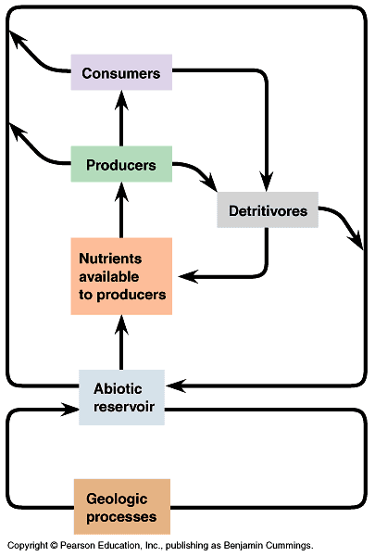
Trophic dynamics & nutrient cycling
Emphasis is on cycling, rather than flow
Note abiotic and biotic parts of cycles
Cycles to know:
Carbon, P, N and water
Decomposition rates are critical
What determines decomposition rates?
Decomposers and detritivore communities
Precipitation
Temperature
Tissue quality (C/N, etc.)

Slide 2
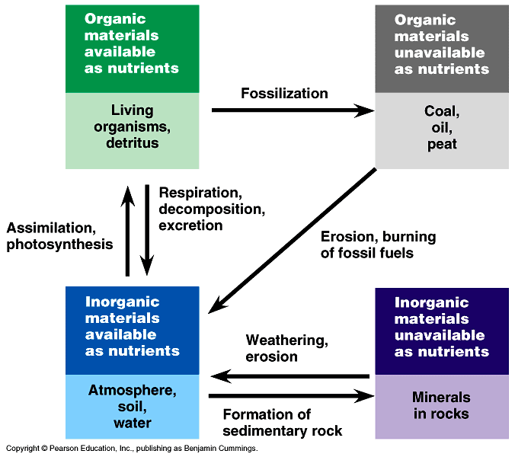

Slide 3
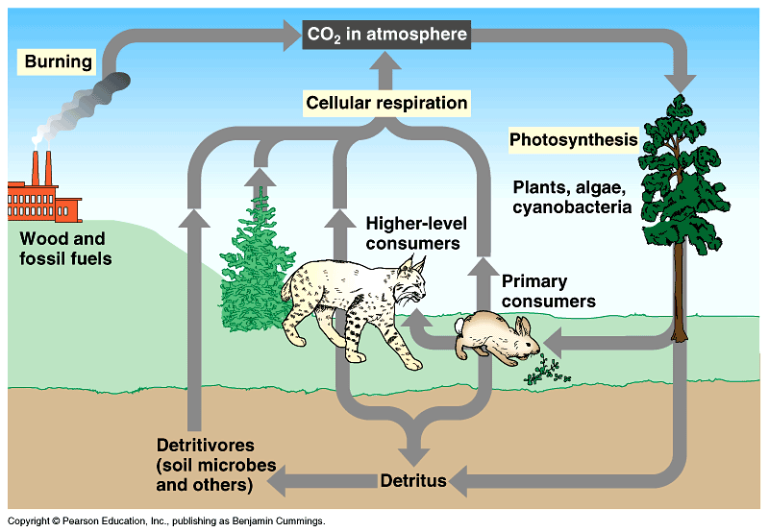
The carbon cycle:

Slide 4
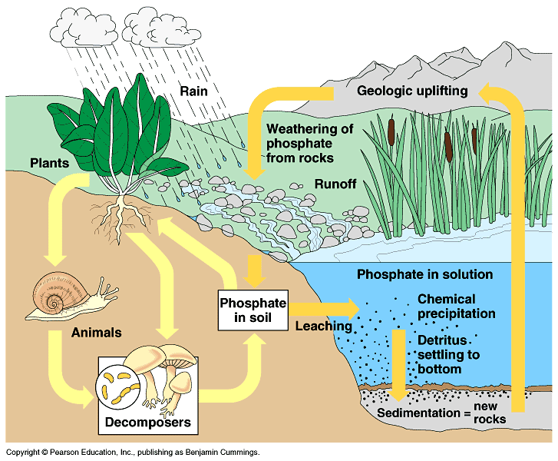
The phosphorus cycle:

Slide 5
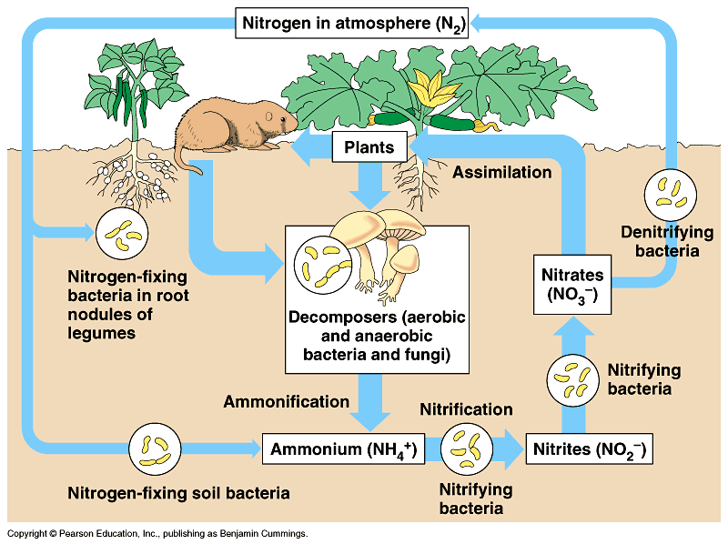
The nitrogen cycle:
atmospheric N & N-fixing bacteria contribute less to the cycle
compared to detritus sources released by decomposers

Slide 6
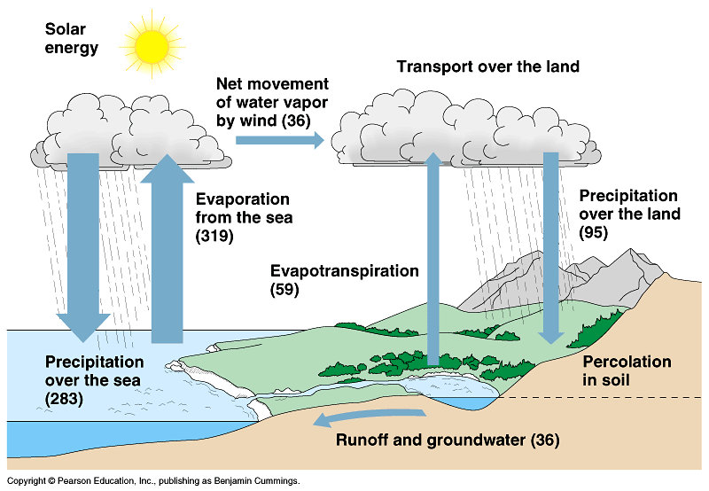
The water cycle

